Slide 1
DO NOT SHOW
Microsoft Cloud Adaption Framework and the Migration Conversation
Speaker:
CSA, FTA, CAT, TSP, SSP
Primary Audience:
Cloud Architect
Impacted Audience:
Sr. IT Pro/IT Operations/Application Owners/Influencers/Decisions Markers
Usage guide:
This presentation is designed to provide a modular, brief introduction of how CAF can help organizations to manage cloud migration efforts, preferably on Azure. Use this deck to kickoff the migration discussion with your customer and introduce our other available resources.
Key contact for support:
cafmigrationhelp@microsoft.com
Additional supporting materials:
Migration Overview: https://aka.ms/adopt/migrate
Azure Migration Guide: https://aka.ms/adopt/migration/guide
Expanded Scope: https://aka.ms/adopt/migration/expanded
Best Practices: https://aka.ms/adopt/migration/bestpractices

Slide 2
DO NOT SHOW
General Information
This presentation contains several aspects – regarding migration theory and the application of migration within Azure
Please tailor it to your individual needs.
(migration, technical discussions, cloud adoption, cloud governance)

Slide 3
Microsoft Cloud Adoption Framework for Azure Migrate
Speaker
Title

Slide 4
Agenda
Cloud Adoption Framework Overview
Motivations
Prerequisites
1st Workload
Mature Process
Expert MSP’s

Slide 5


Key Business Drivers
Modernization
Business Transformation enabled by Cloud Technologies
Improving customer and employee experiences
Transformation
Evolving how businesses operate and interact with the market
Growth
Scaling products and services to meet ever growing business needs
Business Returns
IT must rapidly produce measurable business returns to stay relevant

Slide 6
Microsoft Cloud Adoption Framework for Azure
Business Strategy
Actionable, efficient, and comprehensive Azure cloud guidance from Microsoft to accelerate your adoption journey
Microsoft Cloud Adoption Framework for Azure enables you align business, people and technology strategy to achieve your business goals
Technology Strategy
People Strategy

Slide 7
Microsoft Cloud Adoption Framework for Azure
Adopt
Define Strategy
Understand motivations
Business outcomes
Business justification
Prioritize project
Plan
Digital estate
Initial organization alignment
Skills readiness plan
Cloud adoption plan
Ready
Azure readiness guide
First landing zone
Expand the blueprint
Best practice Validation
Migrate
• First workload migration
• Expanded scenarios
• Best practice validation
• Process improvements
Innovate
• Innovation guide
• Expanded scenarios
• Best practice validation
• Process improvements
Govern
Methodology • Benchmark
initial best practice • Governance maturity
Manage
Business commitments
operations baseline • Ops maturity

Slide 8
Cloud Adoption Framework Migrate: Balance within migration efforts
Lift, Shift, & Optimize
Modernize
Cloud Adoption Framework Migrate provides a single migration methodology that balances Lift, Shift, & Optimize motions and Modernization motions, into one fluid process
Notes:
Lift & Shift is one of many migration approaches. The goal of CAF Migrate is to provide the customer with a single approach that balances the speed of a standard lift & shift with the growth potential of a modernize effort. The purpose of this deck is to expose the methodology and establish a maturity plan to ready the team to execute the iterative processes that fit their needs.

Slide 9

How Do I Get Started?
Motivations
Understand motivations and business objectives which will drive migration decisions
1
Prerequisites
Validate prerequisites aligned to Motivations and Migration Phase Investments
2
1st Workload
Learn the tools and approaches migrating a 1st workload using the Azure Migration Guide
3
Mature Processes
Mature an iterative migration process to align with the needs of your org, existing constraints and candidate workloads
4

Slide 10
Motivations
Understand the motivation and objectives behind the desire to migrate to the cloud

Slide 11
How Do I Get Started?
Motivations
Understand motivations and business objectives which will drive migration decisions
1
Prerequisites
Validate prerequisites aligned to Motivations and Migration Phase Investments
2
1st Workload
Learn the tools and approaches migrating a 1st workload using the Azure Migration Guide
3
Mature Processes
Mature an iterative migration process to align with the needs of your org, existing constraints and candidate workloads
4

Slide 12
Cloud Adoption Motivations
Why is the company adopting the cloud?
More than one motivation is common in most cloud adoption efforts
Critical Business Events
Data center exit
Mergers, acquisition or divestiture
Reductions in capital expenses
End of support for mission critical technologies
Regulatory compliance, data sovereignty requirements
Reduce disruptions and improve IT stability
Migrate Motivations
Cost Savings
Reduction in vendor or technical complexity
Optimization of internal operations
Increase business agility
Prepare for new technical capabilities
Scale to meet market demands
Scale to meet geographic demands
Innovation Motivations
Prepare for new technical capabilities
Build new technical capabilities
Scale to meet market demands
Scale to meet geographic demands
Improve customer experiences / engagements
Transform products or services
Disrupt the market with new products or services

Slide 13

Simplified migration objectives
Migrate Assets (Infra, Apps, or Data) in response to a critical event or need to move specific assets
Migrate Workloads to streamline cost, complexity, and operations
Migrate the Portfolio to improve business agility, tech capability & scale
Notes:
Governance is about meeting strategic objectives (performance) while meeting legal and regulatory, contractual and other obligatory requirements often supported by policies (conformance). The goal is to achieve both in a balanced way.

Slide 14
Clarifying Motivations
Migration Leaning:
Do the team’s plans lean more to one of the following approaches?
Shift & Lift
Modernization
Objective Focus:
Is the team focused most heavily on one of the following objectives?
Workloads
Portfolio
Assets
(infra, apps, & data)
Motivations:
Prioritize the following motivations based on desired business outcomes
Data center exit
Mergers, acquisition or divestiture
Reductions in capital expenses
End of support for mission critical technologies
Regulatory compliance, data sovereignty requirements
Reduce disruptions and improve IT stability
Cost Savings
Reduction in vendor or technical complexity
Optimization of internal operations
Increase business agility
Prepare for new technical capabilities
Scale to meet market demands
Scale to meet geographic demands
Prepare for new technical capabilities
Build new technical capabilities
Scale to meet market demands
Scale to meet geographic demands
Improve customer experiences / engagements
Transform products or services
Disrupt the market with new products or services
Notes:
Clarifying motivations will help drive follow on steps.

Slide 15
Prerequisites
Checklist of things that need to be done before migration

Slide 16
How Do I Get Started?
Motivations
Understand motivations and business objectives which will drive migration decisions
1
Prerequisites
Validate prerequisites aligned to Motivations and Migration Phase Investments
2
1st Workload
Learn the tools and approaches migrating a 1st workload using the Azure Migration Guide
3
Mature Processes
Mature an iterative migration process to align with the needs of your org, existing constraints and candidate workloads
4

Slide 17
You are here
Adopt
Ready
Plan
This deck assumes you are ready to execute the migration process, which is distinct methodology within the Adopt phase of CAF guidance.
This section of the deck helps the customer test readiness assumptions to prevent future roadblocks or re-work

Slide 18

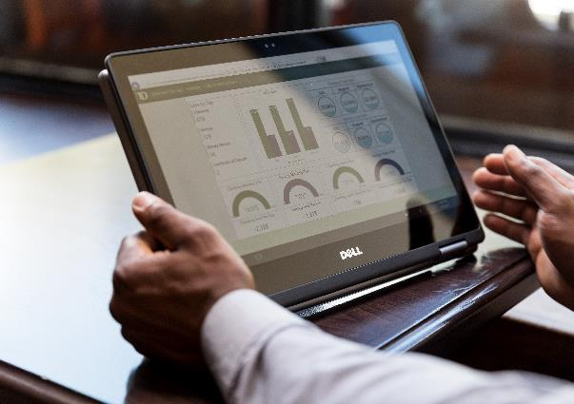

Plan Prerequisites
First workload
Demonstrate a growth mindset by choosing a small, low impact, self-contained first workload for the Cloud Adoption Team to migrate & learn. See next section for guidance on execution.
Business justification
Align the right level of business justification using calculators and Azure Migrate, digital estate rationalization, and/or a migration business case.
Build a migration plan
Align business and technical strategies to rationalization the digital estate and create an initial migration backlog.
Notes:
Before beginning a migration, the above should be completed or in process of being completed

Slide 19


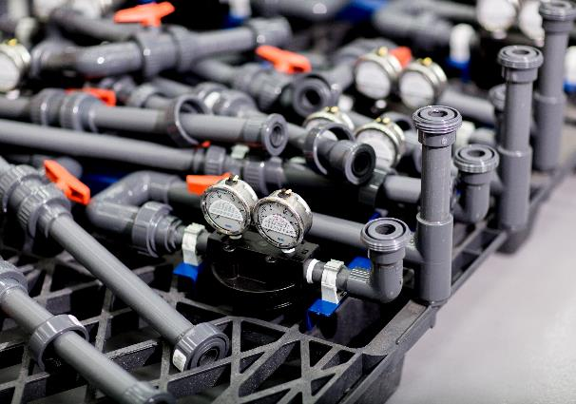
Ready Prerequisites
Business readiness
Create initial org alignment with a Cloud Strategy Team to represent business needs and market changes in the migration backlog
Skill & support readiness
Create a skills readiness plan for staff (IT and Business Staff), identify execution gaps, align key partners, choose support and services options
Environment Readiness
Establish a Landing Zone in the cloud. This target should be readied to handle the workloads and assets being migrated to the cloud
Notes:
Before beginning a migration, the above should be completed or in process of being completed

Slide 20
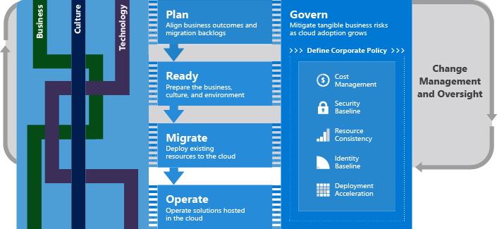
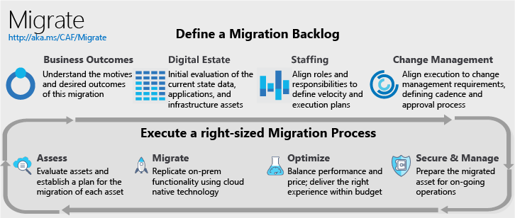
Migration methodology
Prioritize investments of time and energy based on migration objectives
Migration Strategy & Plan
Migration Implementation
Migration Strategy & Plan
Align the business outcomes, priorities, and constraints to establish a migration strategy & plan that outlines the approach to migration and modernization of the IT portfolio, which spans the full collection of data centers, workloads, and/or misc. IT assets supported across all of IT. Proper management of the portfolio across the migration effort will drive the desired business impact.
Migration Implementation
Iterative process for migrating and modernizing the digital estate in alignment with targeted business outcomes and change management controls. During each iteration, workloads are migrated &/or modernized in alignment with the strategy & plan. Decisions regarding IaaS, PaaS, or hybrid are made during the assess phase to optimized control and execution. Those decisions will drive the tools used during the Migrate phase.
Notes:
Note: The three phase names (denoted with an asterix *) are to be tested with customers & refined.
The Asset phase of migration is where most of the technical work happens, moving assets to the cloud.
If the customer has workload objective(s) for this migration, they will need to invest in a bit more structure and follow the workload phase guidance
If the customer has portfolio objectives(s) for this migration, they will also need to invest in the portfolio phase structure.
Every customer will execute the asset phase of migration. Every customer should invest in the full portfolio phase, if they wish to produce business returns from the migration effort.
In a factory model, Asset phase is like the factory floor where the parts are assembled & shipped.
If the customer has

Slide 21
Migration Factory for large portfolio migrations
Migration Plan
Workload Migration
Notes:
Portfolio Phase establishes the design & fills up the backlog with prioritized workloads
Workload Phase manages the flow of inventory in & out of the conveyor belt, including Quality Control on the back end of the belt.
Asset Phase executes the migration or technical change for each asset

Slide 22
First Workload
Select a workload. Execute the Readiness and Migration Guidelines

Slide 23
How Do I Get Started?
Motivations
Understand motivations and business objectives which will drive migration decisions
1
Prerequisites
Validate prerequisites aligned to Motivations and Migration Phase Investments
2
1st Workload
Learn the tools and approaches migrating a 1st workload using the Azure Migration Guide
3
Mature Processes
Mature an iterative migration process to align with the needs of your org, existing constraints and candidate workloads
4

Slide 24
Azure Readiness Guide (Create the first landing zone)
Naming Standards
Resource Organization
Identity and Access
Compute
Network
Storage
Manage
Governance
Configuring virtual machines for availability, scale and performance
Designing the network for current and future connectivity requirements
Planning for performance, durability, scalability and archival
Planning for production operations for monitoring and disaster recovery
Control access to resources, what can be used, setup cost management and chargeback
Build a solid foundation using best practices and prescriptive guidance prior to starting migration efforts
Azure Readiness Guide: https://review.docs.microsoft.com/en-us/azure/architecture/cloud-adoption/ready/azure-readiness-guide/?branch=CAF%2Fmigrate-v1

Slide 25
CAF Ready: Landing Zones (Coming Soon)
CAF Ready: Landing Zones (Coming Soon)
Migration Landing Zone (Blueprint 1: CAF Migrate Landing Zone)
Migration Tooling
(ASR, DMS)
Policy
(Audit only on ISO Policy)
Next: Out of scope for this release
Compute
(VMs)
Data
(SQL PaaS)
Compute
(App service)
Data
(PaaS/blob/stream – (un)Structure)
Storage for VMs
(Disks, Files)
Network
(Simple Vnet)
Storage for Apps
(Blobs, CDN)
Network
(Endpoints)
Generic Landing Zone
Network Design
(Vnet, Hybrid, Firewall, Hub/Spoke, Front Door, Endpoints, xxx)
Storage Design
(Disks, Files, Blobs, CDN)
Compute Design
(VMs, Containers, Apps, etc…)
Data Design
(Structured, unstructured)
Management Groups
Resource Groups
Identity and Access
Policy / Security Center
Naming Standards
Subscription Design
Cost & Billing
Monitoring
Color Code:
Tweak the Readiness Guide
Theory/Considerations/Decision Guides
Prescriptive guidance in Readiness Guide (Extends theory)

Slide 26
Azure Readiness Guide (Use the native tools to migrate your first workload)
Assess
Migrate
Optimize
Secure & Manage
Azure Migrate
Data Migration Assistant
SQL Server Migration Assistant
Site Recovery
Database Migration Service
Data Box
Cost Management
Security & Management
Azure Migration Guide: http://aka.ms/caf/migrate
Notes:
Our goal is to enable successful Azure migration, regardless of what tool was used.
We have a great set of first party Azure tools that are built into the Azure portal and free to get started.
But we also have a great set of third party tools to meet all your requirements. For example: Cloudamize, Movere, Turbonomic, TSO Logic can discover a broader set of environments than Azure Migrate does today. Similarly, tools like Zerto and Cloud Endure can migrate a broader set of OS’es to Azure as compared to Azure Site Recovery.
We’re also working closely with the ecosystem to build out a unified experience across Azure and 3rd party tools.

Slide 27
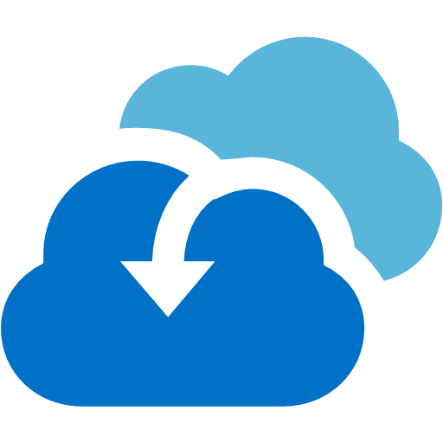

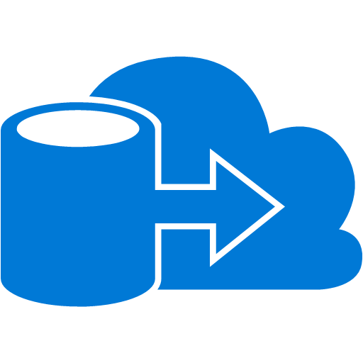
Planning for the first workload
Objective: Migration of the first workload is a highly suggested learning experience, which should come early in any migration effort. The goal is to deploy one or more production ready workloads. However, this is done to provide the team with the ability to learn the tools and the Azure platform. That learning will help make the right long-term decisions, even if those workloads don’t ever get promoted to production traffic.
Domain Alignment:
Choose a workload that represents the domain focus that will be used throughout the migration plan.
Workloads
Applications
VMs
Select a Toolchain:
Choose one or two migration tools to use for this first migration
Azure Site Recovery
App Service Migration Tool
Data Migration Service
Workload Selection:
The following checklist can aid in selection of a first workload
Low impact to end users & business processes
Performance of the workload is established and can be tested
Performance impacts during this experiment won’t negatively impact critical processes
Application Owner is supportive of the cloud migration objectives
Subject Matter Experts for the workload should be aware or even involved in the migration
Operations staff for the workload should be aware or even involved in the migration
IT experts from networking, identity, security, governance, and compliance should be aware or even involved in the migration
The migration landing zone should be validated prior to migration
Well maintained (Current on patches & updates)
Limited infrastructure complexity (Small number of assets)
Limited dependencies (All dependencies should be moved in the first workload migration)
Limited exposure (No mission critical applications or sensitive data)
Notes:
Clarifying motivations will help drive follow on steps.

Slide 28
Iteratively mature migration processes
Mold the baseline guidance to fit your business objectives, organizational structure, existing constraints, and individual workloads.

Slide 29
How Do I Get Started?
Motivations
Understand motivations and business objectives which will drive migration decisions
1
Prerequisites
Validate prerequisites aligned to Motivations and Migration Phase Investments
2
1st Workload
Learn the tools and approaches migrating a 1st workload using the Azure Migration Guide
3
Mature Processes
Mature an iterative migration process to align with the needs of your org, existing constraints and candidate workloads
4

Slide 30
Mature migration processes (End state & actions)
Mature migration processes (End state & actions)
Aggregate data to execute a workload, constraint, & dependency analysis
Align sub-processes to fit the teams, roles, & responsibilities
Ensure every member of the team can use business outcomes as a test for decisions
Align sub-processes to fit change management and change approval processes across IT and business unit
Mature Assessment:
Quickly evaluate cloud compatibility
Align appropriate cloud architecture
Match the appropriate migration tool
Mature Migration:
Standardized process
Allow multiple migration tools
Enable limited workload modernization during migration
Mature Optimization:
Data-driven testing
Balance of performance and cost
Low impact promotion process
Consistent on-boarding
Mature Operations:
Integration with ops, governance, and security
High workload reliability
Well-governed environment.

Slide 31
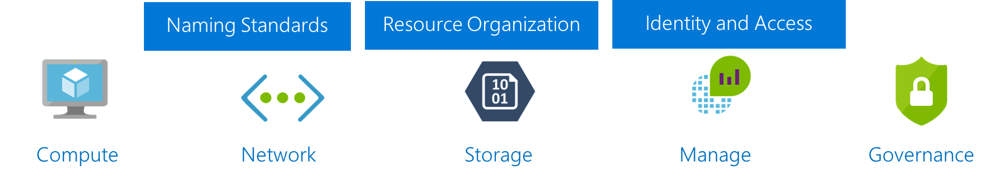
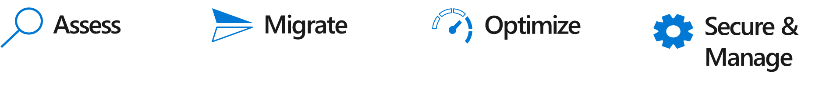
Maturing Migrating Processes
Key maturity motions
Business
Migration backlog review, release, & realignment processes
First Workload (Migrate MVP)
Evolve and align Definition of Done to match org structure
People
Culture of learning; continuously expand skills
Azure Readiness Guide
Azure Migration Guide
Increase assessment decisions accuracy w/ better data
Target: ~50 assets
(Infra, Apps, & Data)
Expand workload architecture options w/ broaden tooling
Technology
Improve optimization w/ testing & monitoring options
Expand initial architectures for reliability and resiliency

Slide 32
Improve assessment accuracy
Increase assessment decisions accuracy w/ better data
With each release leverage Azure Migrate to improve workload definitions by grouping relevant servers
Improve assessment decision accuracy by aligning the business value of workloads with key technical decisions regarding compatibility, performance, dependency, and costs

Slide 33
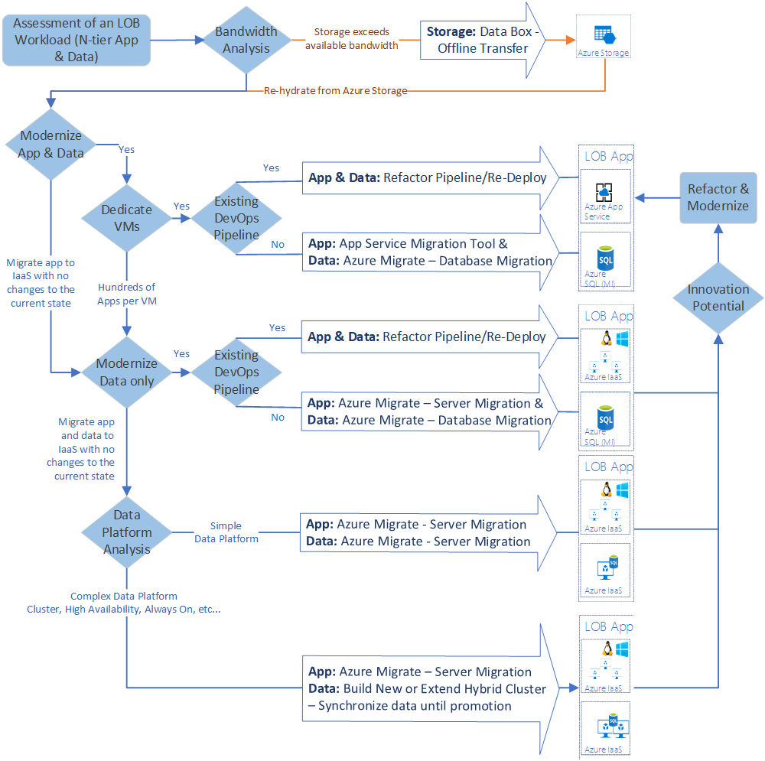
Migration tooling Options
Expand workload architecture options w/ broaden tooling
Migration is more than a shift & lift rehost to IaaS using tools like Azure Site Recovery.
Modernize some assets during migration with PaaS focused solutions like Database Migration Service
Over time, refactor and modernize any workloads that represent innovation potential

Slide 34



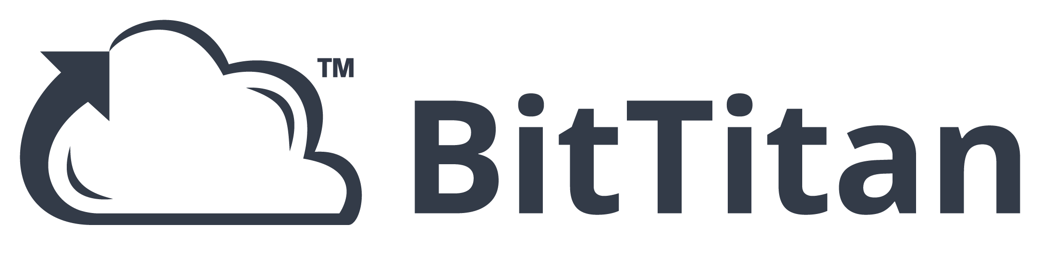






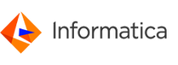
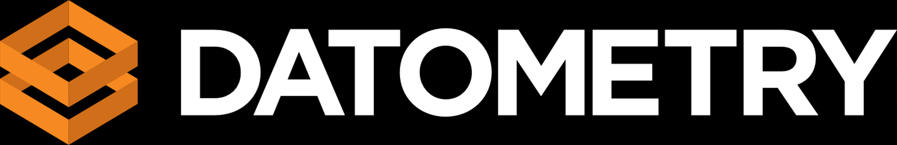


Migration tooling options
Migration tooling options
Expand workload architecture options w/ broaden tooling
Assess
Migrate
Optimize
Secure & Manage
Azure Migrate
Azure Site Recovery (ASR)
Azure Cost Management
Azure Advisor
Azure Security & Management
(e.g., Blueprints, Security Center, Backup, Monitor)
Data Migration Assistant (DMA)
Azure Database Migration Service
SQL Server Migration Assistant (SSMA)
Azure Data Box
ISV solutions (as needed)
Notes:
Our goal is to enable successful Azure migration, regardless of what tool was used.
We have a great set of first party Azure tools that are built into the Azure portal and free to get started.
But we also have a great set of third party tools to meet all your requirements. For example: Cloudamize, Movere, Turbonomic, TSO Logic can discover a broader set of environments than Azure Migrate does today. Similarly, tools like Zerto and Cloud Endure can migrate a broader set of OS’es to Azure as compared to Azure Site Recovery.
We’re also working closely with the ecosystem to build out a unified experience across Azure and 3rd party tools.

Slide 35
Example: Migrate only
Expand workload architecture options w/ broaden tooling
On-premises
Azure
VMware
LOB App
LOB App
Web & App layer
Azure IaaS VMs
Web & App layer
Windows Server 2008 R2
Data layer
Azure IaaS VMs
Azure Site Recovery
Data layer
SQL Server 2008 R2
Azure Migrate
Documentation: https://aka.ms/rehostapp_model2
For shared disk SQL clusters – leverage Always-ON

Slide 36
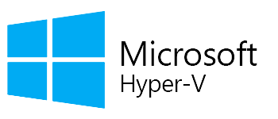
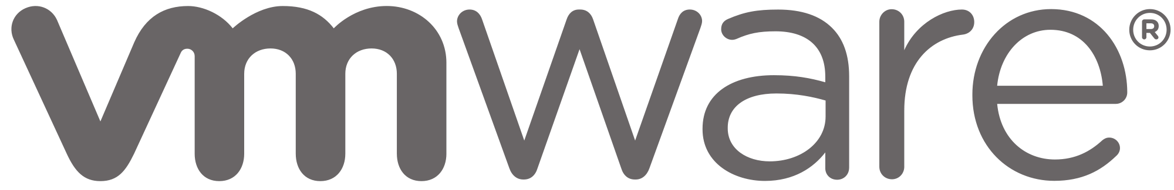
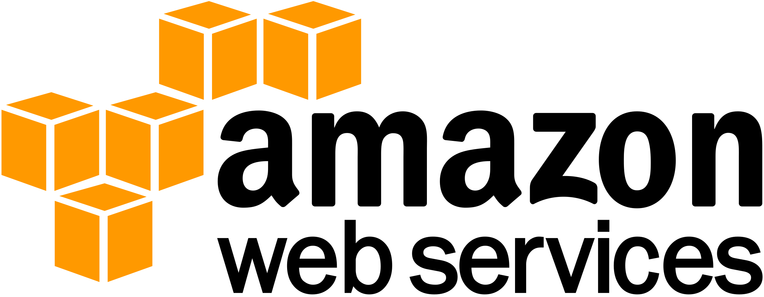

Azure Migrate – Server Migration
Expand workload architecture options w/ broaden tooling
VMware, Hyper-V, AWS, GCP, Physical Servers
1. Deploy the Azure Migrate appliance
2. Replicate Windows or Linux servers from VMware, Hyper-V, AWS, GCP; we support migration of physical servers as well
3. Test migration without production impact, perform near-zero downtime migrations and achieve zero application data loss
Notes:
This slide is required. Do NOT delete. This slide is recommended just prior to the “session resources” slide
SESSION TAKEAWAYS & ACTIONS: Bullet points highlighting the primary actions learners should take away or knowledge learners should recall to help them successfully perform in role (e.g. practical guidance, tips, suggested behavior changes.)
Please Note: Session Takeaways are not required to be noted in this slide for Group Discussions (formerly known as Chalk Talks) or Workshop sessions; however, takeaways should be captured real time by the facilitator during the session and those key points should be emphasized during the discussion or workshop. If you have questions, please contact your Track Content Lead.

Slide 37
Example: Migrate & Modernize
Expand workload architecture options w/ broaden tooling
On-premises
Azure
VMware
LOB App
LOB App
Azure Site Recovery
Web & App layer
Azure IaaS VMs
Web & App layer
Windows Server 2008 R2
Data layer
Azure SQL Database Managed Instance
Data layer
SQL Server 2008 R2
Azure Database Migration Service
Azure Migrate
Documentation: https://aka.ms/rehostapp_model1

Slide 38
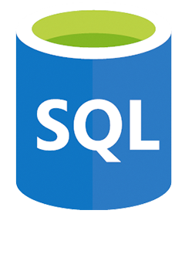
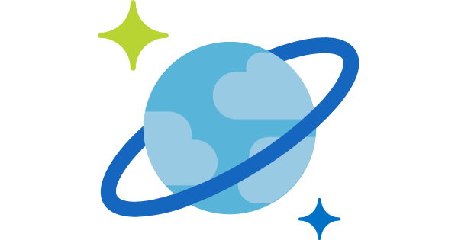
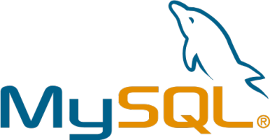
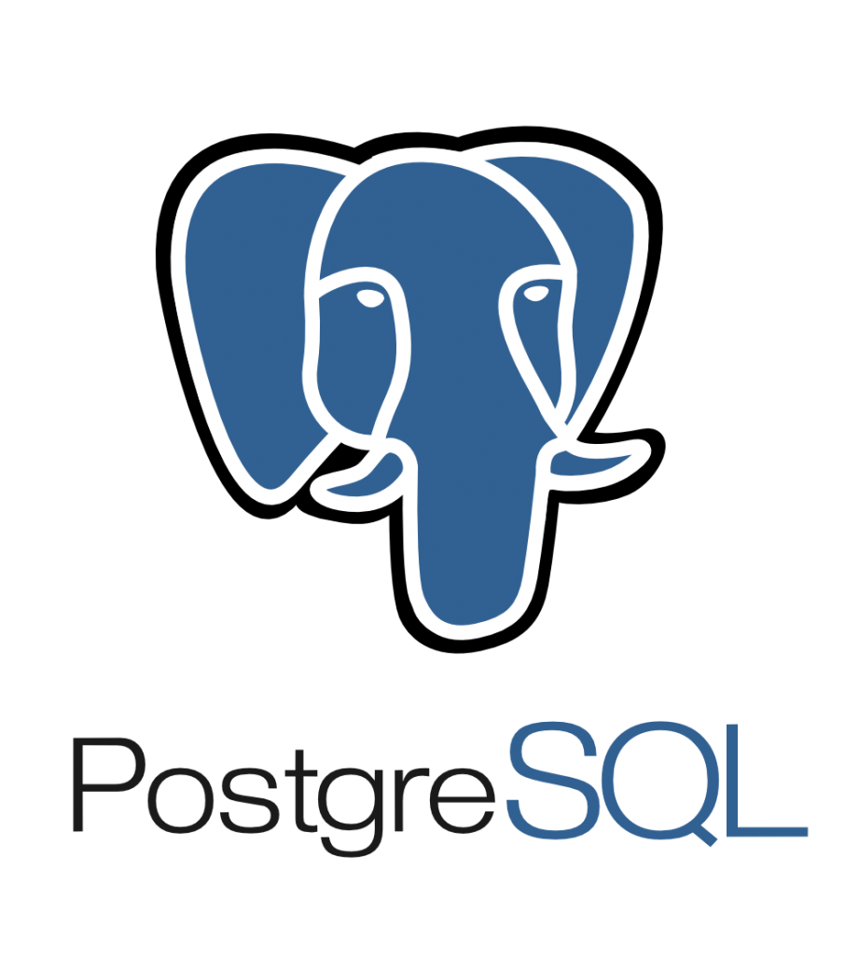
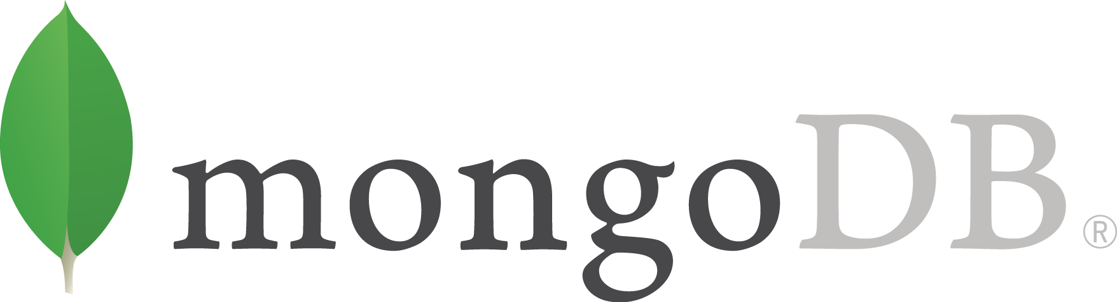
Azure Migrate – Database Migration
Expand workload architecture options w/ broaden tooling
Seamless, end-to-end solution for moving databases to the cloud from on-premises and AWS RDS
Assessments across various database targets including Azure SQL Database and Managed Instance
Achieve near-zero downtime as you migrate your business-critical applications
Migrate at scale from multiple sources to your target database
Notes:
Azure Database Migration Service (DMS)
Azure DMS is a fully managed service designed to enable seamless migrations from multiple database sources to the Azure Data platform.
DMS value prop
Seamless, end-to-end solution
Near-zero downtime as you migrate your business critical apps
Migrate at scale from multiple sources to your target database
41K+ databases have been migrated using DMS in less than 1 year
DMS enables two types of migration:
Offline, one-time migrations (with some downtime)
Online migrations with continuous sync and minimal downtime – for critical workloads

Slide 39
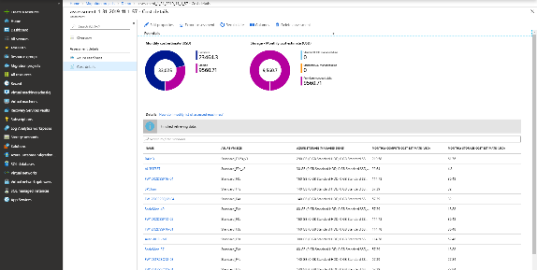
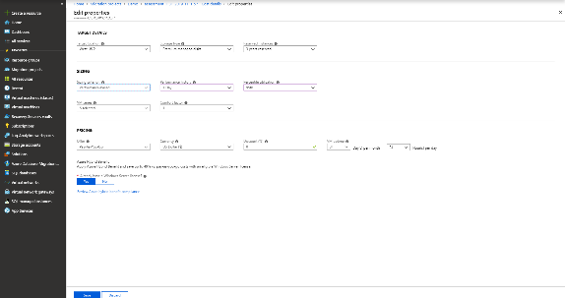

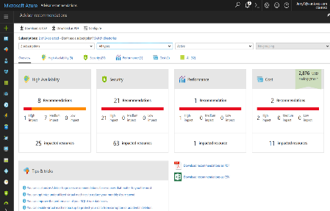
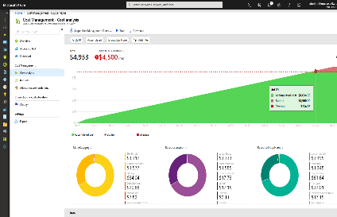
Continuously optimize resources during and after migration
Improve optimization w/ testing & monitoring options
As you move
Right-size Azure resources based on assessment guidance
Use Azure Hybrid Benefit and Azure Reserved Instances to save money
After you move
Unified experience to optimize cloud spends: Azure Cost Management
Azure Advisor: Built-in best practice recommendations
(e.g., turn off idle VMs)
Balance optimization and performance decisions with
Azure Monitor
Modernize for longer term value
Notes:
Let us now transition to the Optimize phase in the Azure migration journey.
Many customers look to the cloud to gain operational efficiencies and cost savings. With Azure Cost Management , customers can now manage their cloud spend in a unified experience, and leverage built-in best practice recommendations (e.g., turning off idle VMs) to drive operational efficiency. They can apply Azure Hybrid Benefit and Azure Reserved Instances during or after migration for big savings.
Link to blog

Slide 40

Expand initial architectures for reliability and resiliency
Example of resilient architecture options
Cloud Infrastructure Architect | Cloud Infrastructure Ops
Premium Storage
Availability Sets
Availability Zones
Azure Site Recovery / Region Pairs
Region 2
Region 1
Data center 1
Single VM
Data center
Zone 1
Zone 1
Infrastructure
(applications and data)
Rack 1
Rack 2
Data center 2
Zone 2
Zone 3
Zone 2
Zone 3
Hardware failure
Rack level failure
Datacenter outage
Natural Disaster
Accidental data loss
Data corruption
Ransomware
Data
(stateful)
Restore to a certain point in time with healthier data
Backup
Learn more about org roles, best practices, and Azure capabilities at the 4/19 briefing: Achieving Resilience in the Cloud
Notes:
Just in 2018, 28% of customers have experienced data loss and 40% have experienced an unplanned outage. Just 2% of organizations recovered from their latest incident in under an hour. Azure’s overall availability has been trending up constantly and is now at over 99.999% reliability across the fleet. Microsoft’s cloud technology provides innovative features such as memory-preserving host updates and live migration. But more importantly, Azure provides a comprehensive set of built-in resilient services to recover from hardware failures, natural disasters and data loss. As a result, we see more customers enable their mission-critical workloads on Azure.
So we have seen how Resilience is not about avoiding any failure but bouncing back from one. Let’s look at some typical failures that may lead to a downtime for your application –
This trapezium shows the degree of impact that a failure can potentially cause. So while, a power or a network outage may impact a datacenter of a multiple data centers in a zone; something more catastrophic like a flood or earthquake can take down the entire region. All these failures primarily impact your infrastructure (which comprises of both applications and the data).
There’s one thing that is common across though, no matter what your deployment is (you can be running the entire set up in a single region vs spread across zones), you will most likely have data; data which is stateful; data which you would need to go back to.
The failures impacting this data look like these. And to draw a parallel, these too in some sense have varying degree of impact of these failures on the data; while accidental deletion may lead to losing a file or folder; a rogue admin can wipe off not only your data but also your backups.
Thus, we need to build resilience against all these failure and the azure services can help us achieve just that.
Opt for Premium storage that allows for 99.5% availability in case of a single VM deployment.
Up your Resilience game with High Availability structures; deploy your architecture in Availability sets or AZs to get SLA up to 99.99%. HA should be preferred for your mission critical apps which have very stringent RPO and RTO requirements (almost real time).
Go one step head to further isolate your VMs by making used of paired regions in azure. The recently previewed feature for storage account failover when configured for GRS also is a subset of this solution.
But none of them still covers you for data failures; and that’s because all of these deployments are almost constantly syncing data across; so if any data corruption happens and I need to go back in time to say a couple of days, I need to have backed-up that version. Hence, we have Backup.

Slide 41
Expert MSPs
Partner with an Azure Expert Managed Service Provider to migrate and operate workloads into a controlled environment managed and operated by the Expert MSP.

Slide 42

What are CIOs thinking?
How can my organization better serve the line of business
to grow the business?
My datacenter lease is coming up for renewal. Do I need to have competency in datacenter operations for being successful?
Should I hire a Cyber Security expert
to look at IT vulnerabilities?
Is there an opportunity to optimize IT Spend?
Is our webapp secure and will it stay up and running reliably during critical periods?
Does my organization lack the right skillsets?
To take advantage of AI, IoT, serverless, etc.?
“Should I have a new team
focused on business enablement or stay focused on keeping the lights on?

Slide 43
Cloud Service Providers
Helping in your transformation Cloud lifecycle management
“Managing the Cloud Lifecycle”
Consulting Services
Cloud Tooling
Consulting Services
Plan & Design
Cloud Assessment
Cloud Assessment
Cloud Enablement
Cloud
Planning
Cloud
Enablement
Cloud Operations
Cloud
Planning
Cloud
Operations
Educate
Align
Develop Plans and Backlogs
Lift & Shift
App re-platform
New App Development
App Optimization
Service Delivery
SLA
Support
Monitoring & Management
Security
Analytics
Tools & Processes
Backup & Recovery
App optimization
Governance
Compliance
Managed Billing
Cloud
Enablement
Managed Services
Build & Migrate
Consulting Services
Cloud Assessment
Cloud Enablement
Cloud Operations
Run & Optimize
Cloud MSPs move but more importantly operate the applications in the Cloud
Notes:
Morph lifecycle to left hand side and breakout each pillar

Slide 44
Thank You

